Slide 1

ADSP 32021 IP01 MACHINE LEARNING OPERATIONS Data-Driven Models for Accurate Car Valuations

Slide 2




TEAM 3
Yash Bhardwaj
Nia
Gangar
Arushi Makraria
Praveen N Mohankumar
Senior ML Engineer
Senior Data Scientist
Data
Scientist
Data
Scientist
Model Training & Evaluation
AutoML & Model Monitoring Test
Feature Engineering & Pipeline Design
EDA & Deployment

Slide 3


BUSINESS PROBLEM
PROBLEM STATEMENT
How can we accurately predict the resale price of a used car based on its features such as manufacturing year, present market price, kilometers driven, and ownership history?
GOAL
Build a machine learning pipeline to predict the Selling Price of used cars, using AutoML to refine the category of algorithms and optimize model performance. Deploy the model with monitoring to ensure reliability and evaluate the impact of feature modifications on predictions.

Slide 4
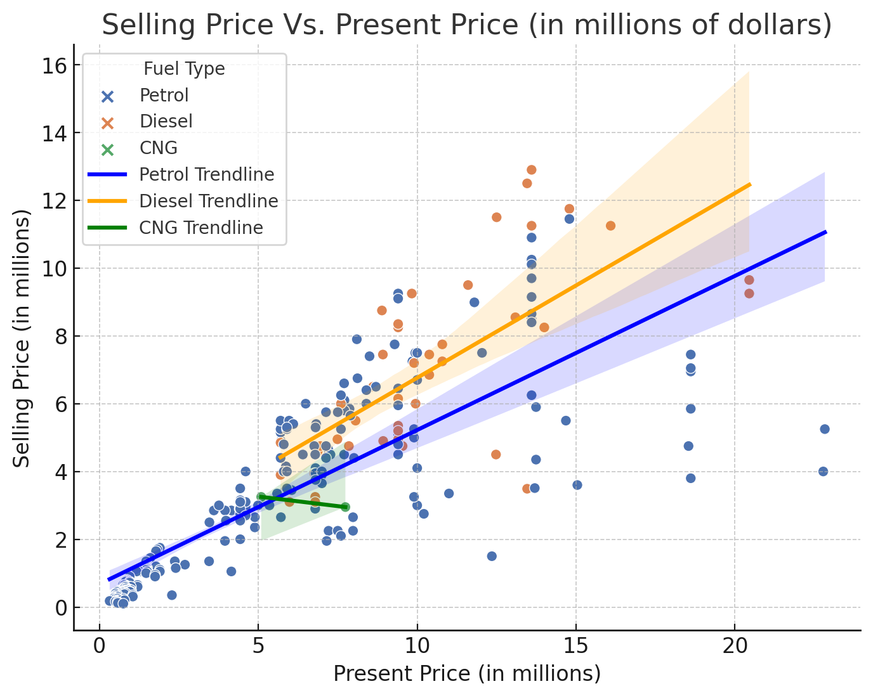
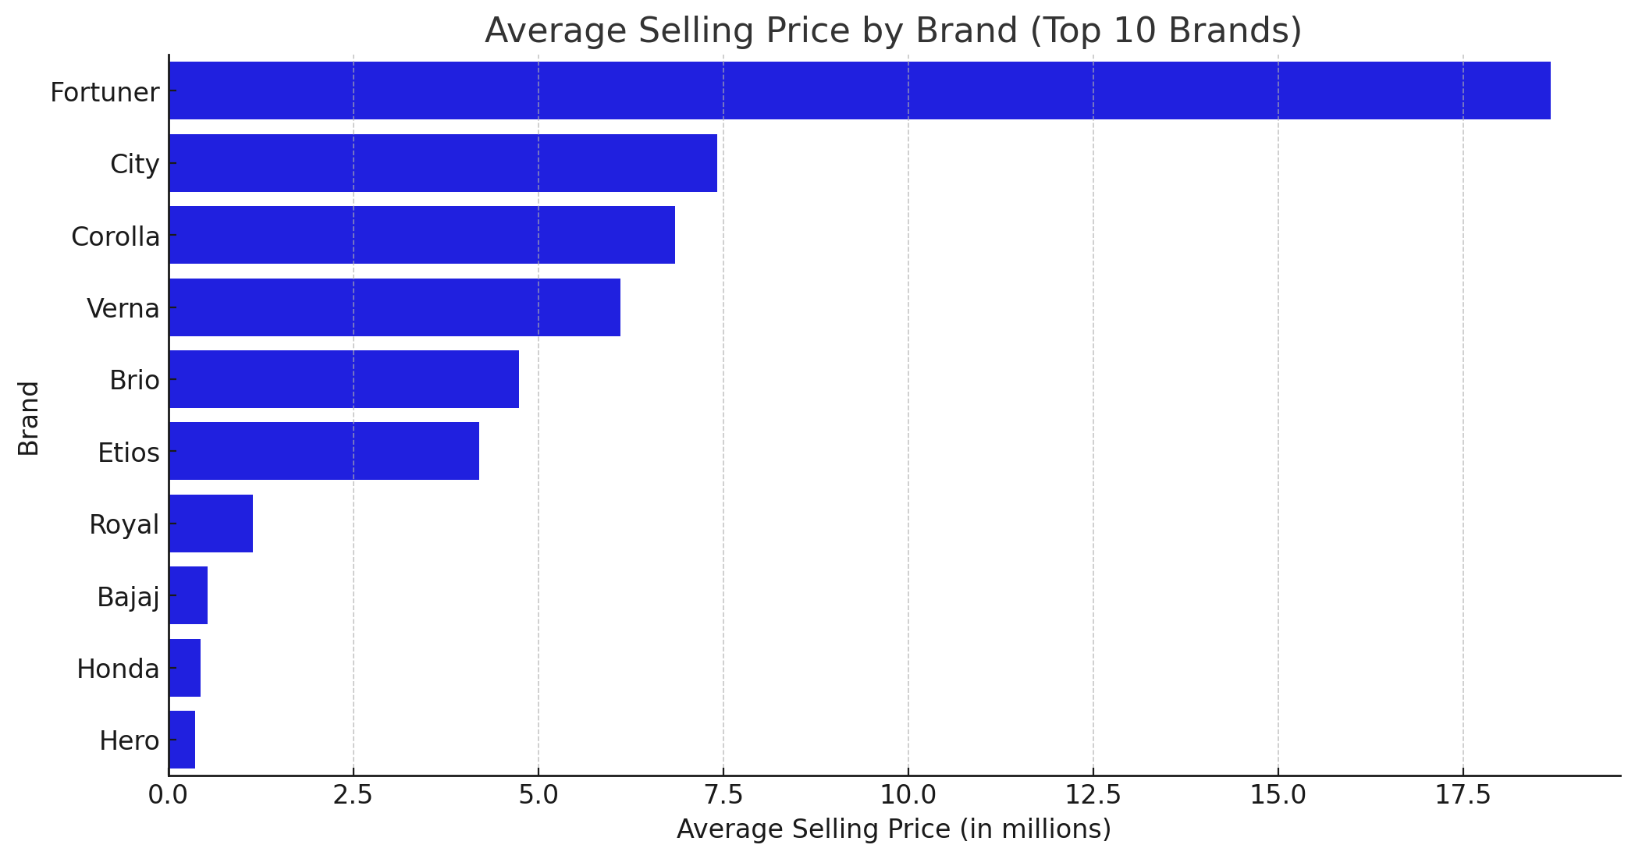
DATA OVERVIEW – EDA 1
******

Slide 5
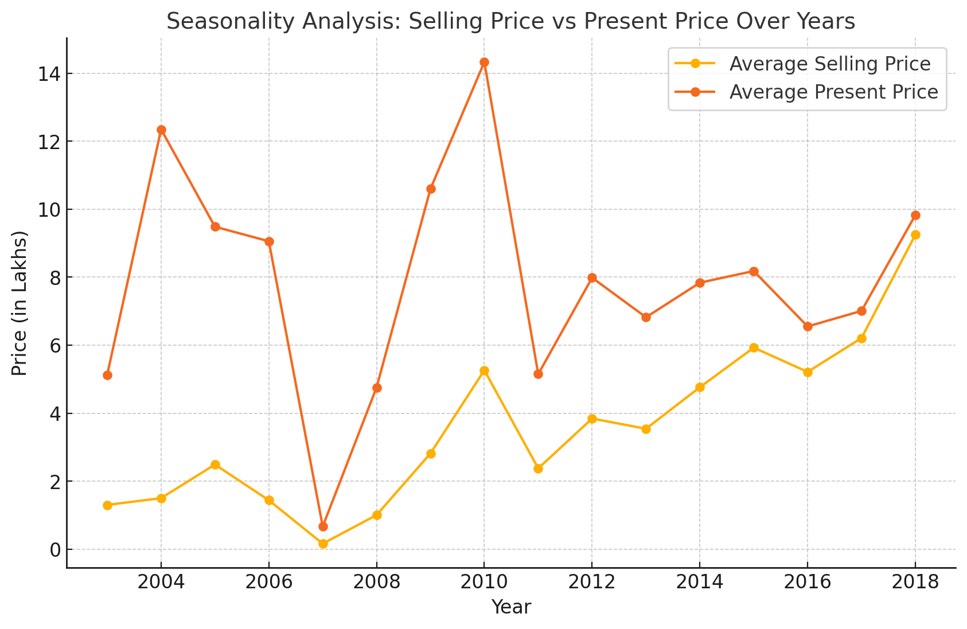
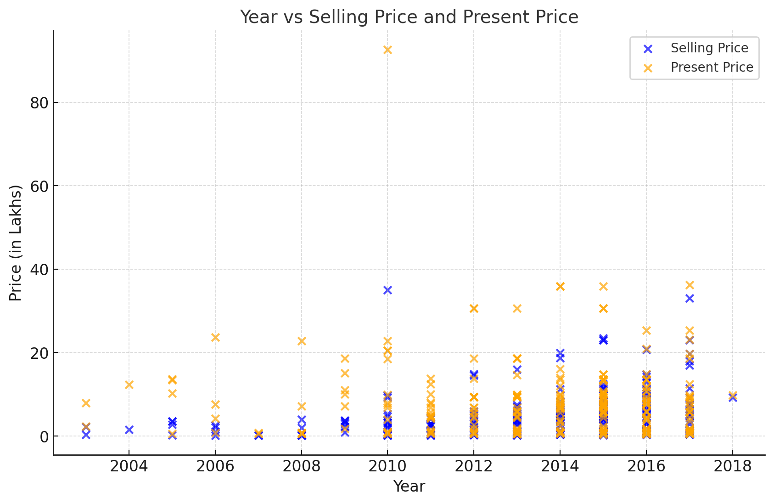
DATA OVERVIEW – EDA 2
The
******
Price in Millions
Price in Millions

Slide 6
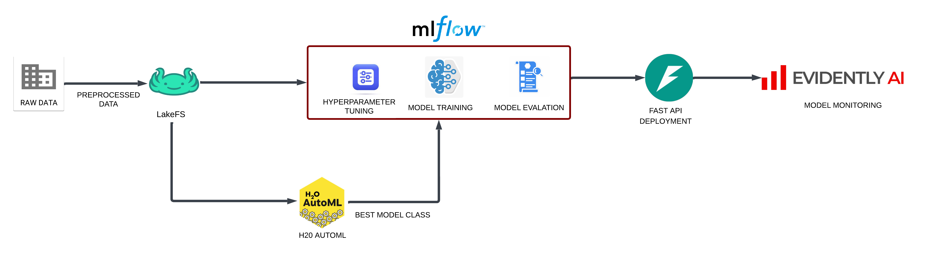
PIPELINE TO TRAIN THE MODEL
An end-to-end ML pipeline using H2O AutoML, lakeFS, and MLflow for model training, evaluation, and monitoring with Evidently AI.

Slide 7
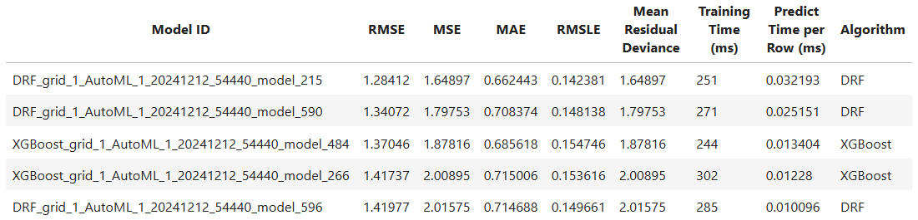

AUTO ML & CHOOSEN ALGORITHM
Top Algorithm: DRF (Distributed Random Forest)
Key Metrics:
RMSE: 1.284
MAE: 0.662
RMSLE: 0.142
Why DRF?
Outperformed other models like XGBoost in error metrics.
Balanced training (251 ms) and prediction speed (0.032 ms/row).
Notes:
Add H2o logo

Slide 8
MODEL TRAINING & MONITORING
Insert Video showing HTML files

Slide 9
TEST DATA SET – CHANGE
Insert Video showing HTML files

Slide 10

GITHUB LINK TO THE PROJECT
GitHub Link

Slide 11

Thank You !

